Slide 1
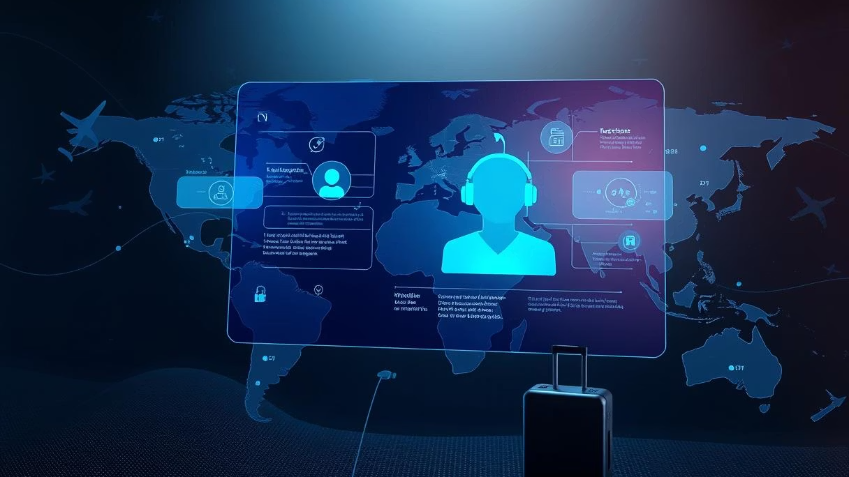
Unlocking Seamless Journeys
Introducing Our AI-Powered Travel Assistant
Revolutionizing trip planning with personalized, interactive experiences built on the robust MERN stack.

Slide 2
The Power of MERN: Foundation for AI Travel
1
2
3
MongoDB
Express.js & Node.js
React.js
Flexible, schema-less JSON data storage for diverse AI data and user profiles.
Scalable backend for real-time API handling, supporting high concurrent requests.
Dynamic, responsive frontend for an intuitive chat interface and rich UX.
The unified JavaScript stack simplifies development, ensuring seamless AI integration and rapid feature deployment.

Slide 3




Experience the Future of Travel Planning
Personalized Itineraries
Real-Time Search
Crafted based on your unique preferences and past travel.
Instant flight and accommodation suggestions.
Interactive Chat
Multilingual Support
Refine plans and get advice through natural conversation.
Contextual recommendations, wherever you are.
Streaming responses ensure a smooth, low-latency user experience.

Slide 4
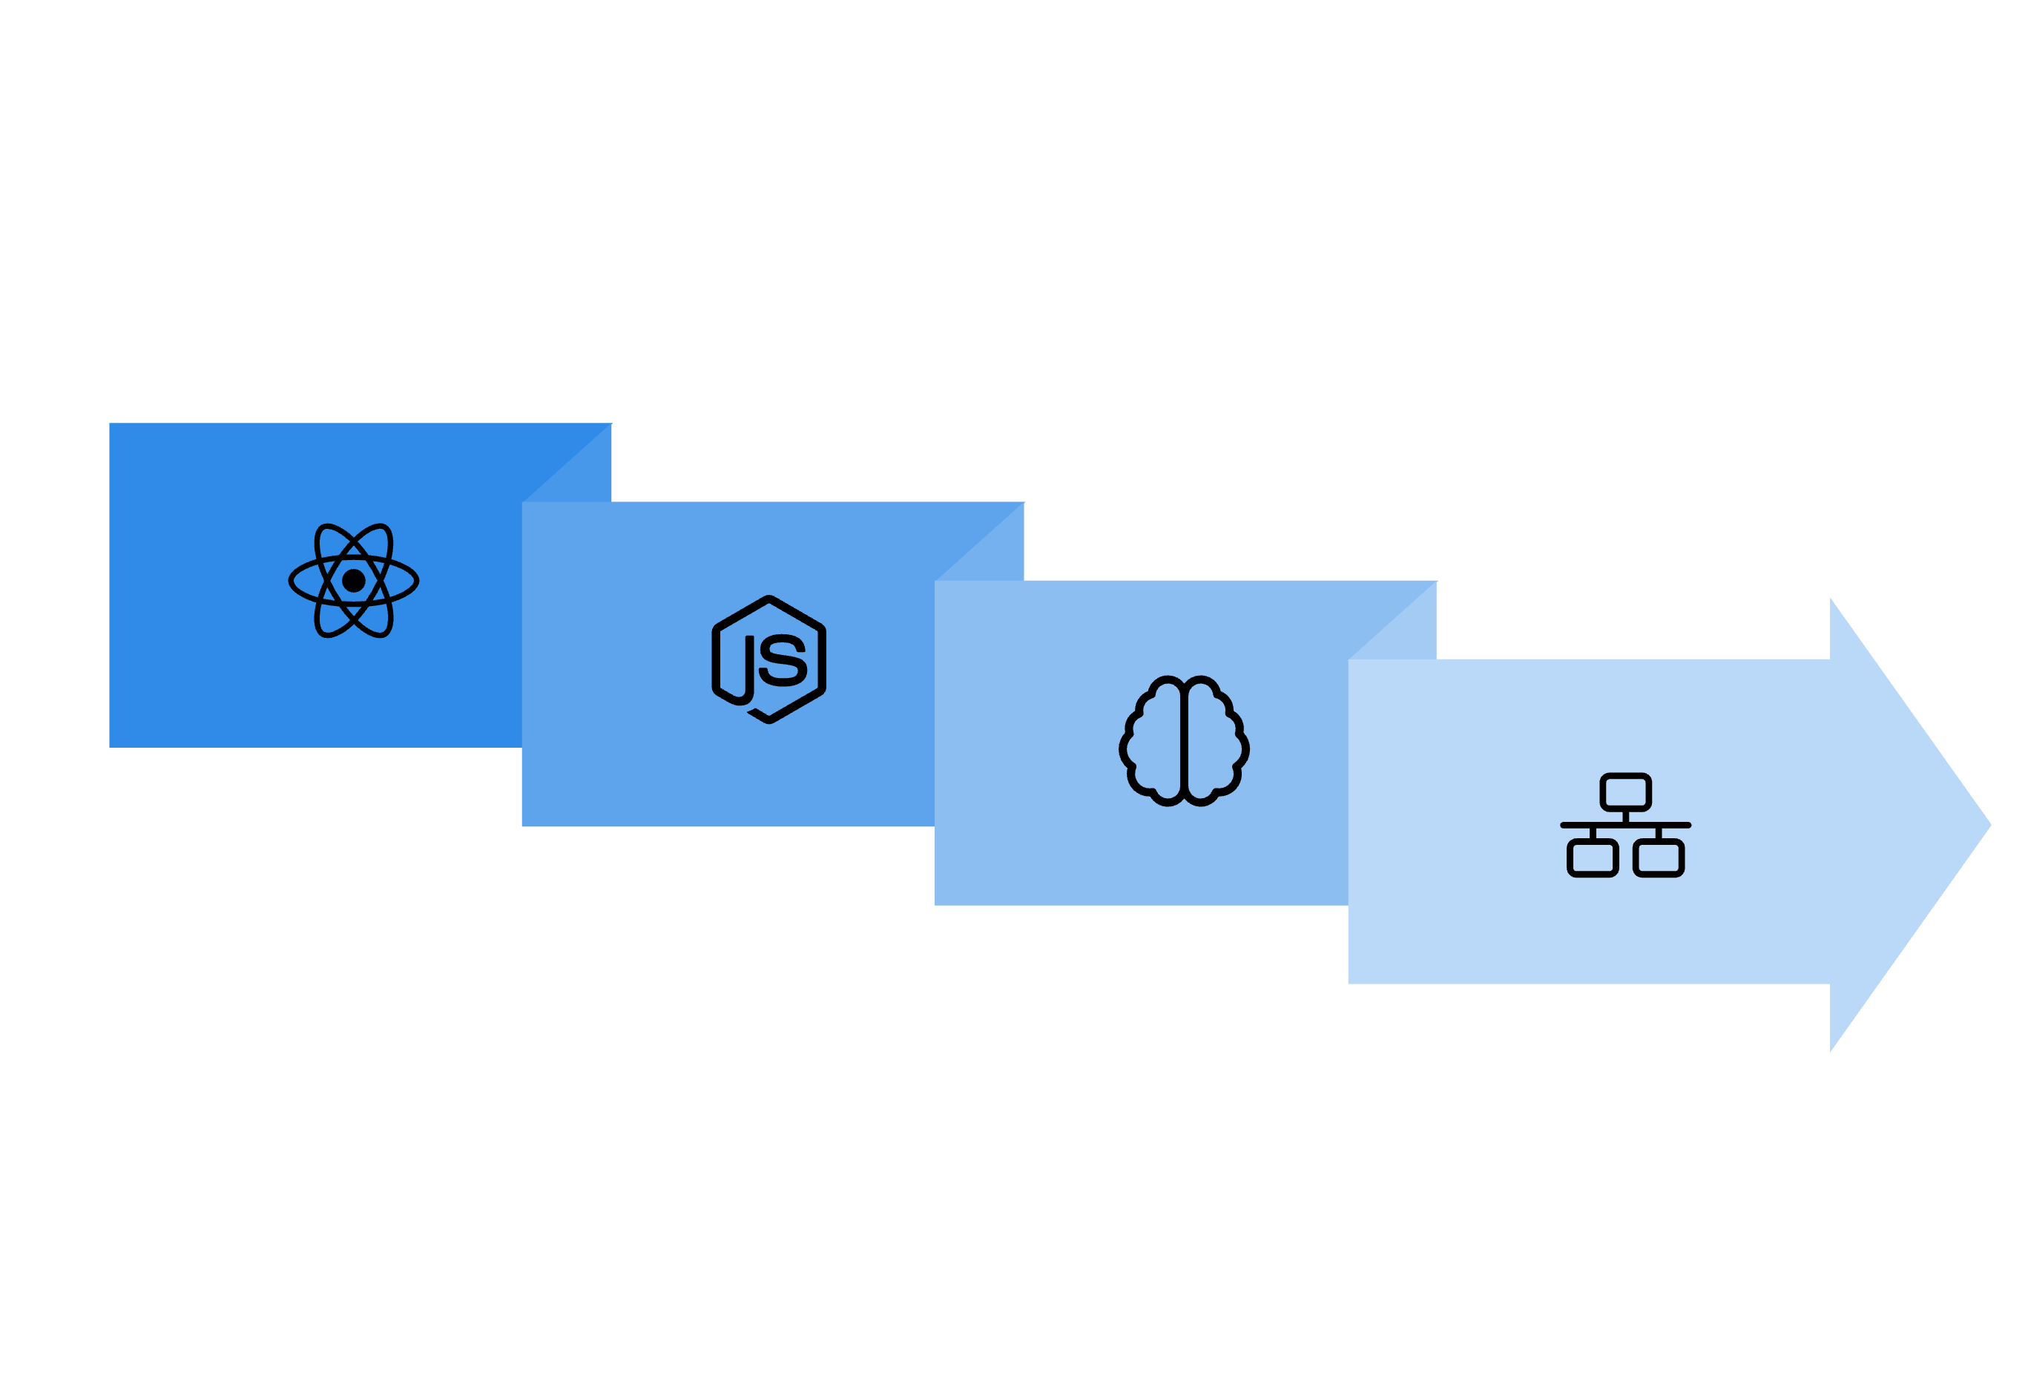




Under the Hood: Robust Technical Architecture
Node.js Backend
API Connections
React Frontend
AI Model Integration
Our architecture ensures seamless real-time interactions, from dynamic chat updates to intelligent API calls for live data, all powered by advanced AI and persistent user context.

Slide 5
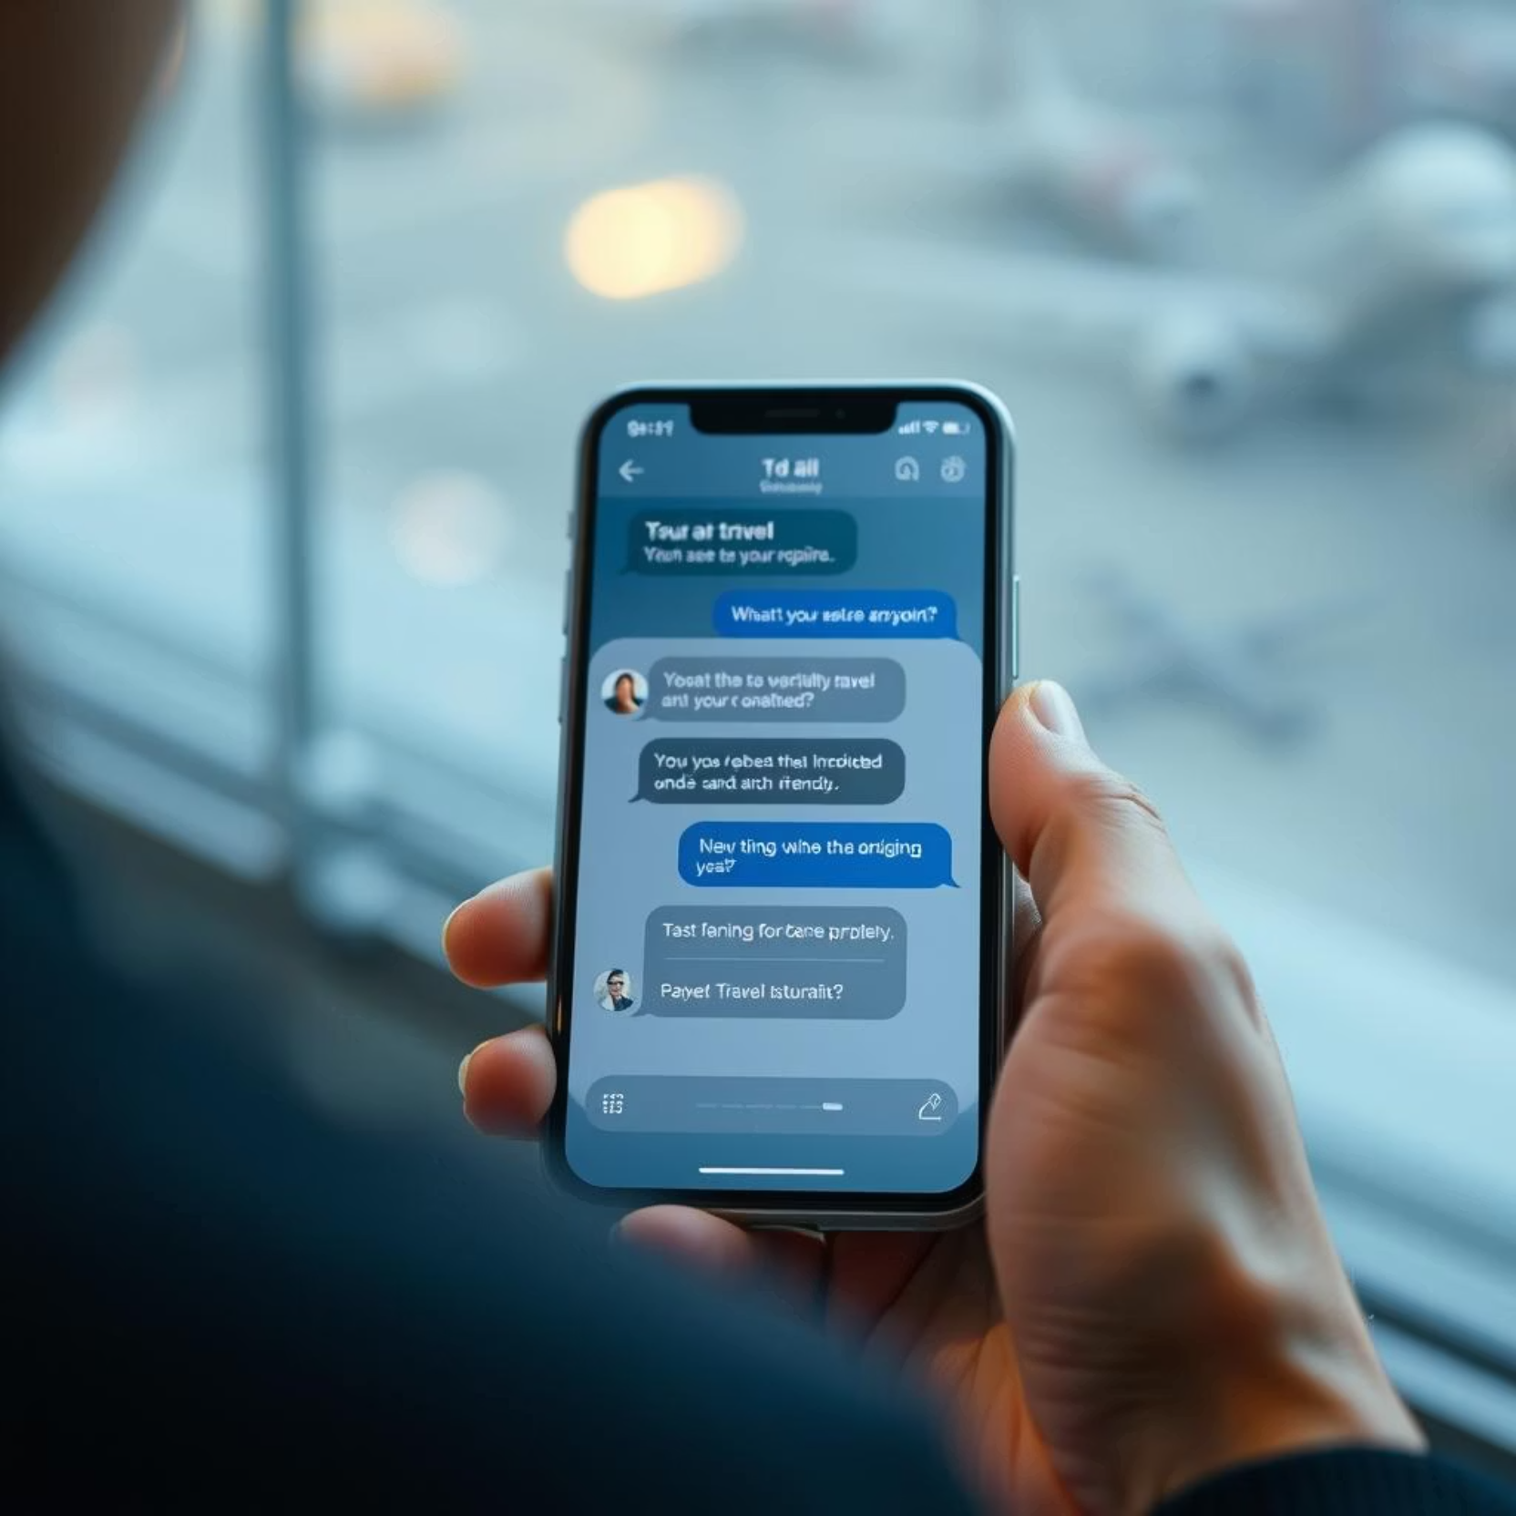
Intuitive User Experience
Simple Q&A: Easily input trip details through natural conversation.
Instant Updates: Itinerary changes are applied immediately based on feedback.
Comprehensive Suggestions: Discover attractions, dining, transport, and essential services.
Always-On Support: Your virtual assistant is ready 24/7 for any travel query.
Mobile-Friendly: Designed for seamless access on any device, anywhere.

Slide 6


Scalability & Future-Proof Integration
Modular Design
Flexible AI
MERN components enable easy expansion and new features.
AI models can be updated or swapped without frontend changes.
Data Scalability
Secure & Private
MongoDB handles growing user data and preferences effortlessly.
Best practices for user authentication and data protection.
Ready for integration with payment gateways, real-time weather APIs, and advanced collaborative planning tools.

Slide 7
Journey Forward: Our Vision
MERN's Robust Foundation
Transforming Travel
Provides the flexibility and power for advanced AI applications.
AI assistants personalize planning, making every trip unique.
Leading the Market
Future Innovations
Opportunity to dominate the AI-driven travel technology sector.
Advanced booking, real-time weather, and more intelligent editing capabilities.
We're ready to deliver smarter, more engaging, and truly personalized travel experiences.

